Slide 1
NTE 1010
Introduction to Finance for Engineers
week
9
Banking

Slide 2
NTE 1010 – Introduction to Finance for Engineers
Banks
Balance Sheet
The balance sheet of commercial banks
can be thought of as
a list of the sources and uses of bank funds.
A bank’s liabilities are its sources of funds,
which include checkable deposits, time deposits, discount loans from the Fed, borrowings from other banks and corporations, and bank capital.
A bank’s assets are its uses of funds,
which include reserves, cash items in process of collection, deposits at other banks, securities, loans, and other assets (mostly physical capital).

Slide 3
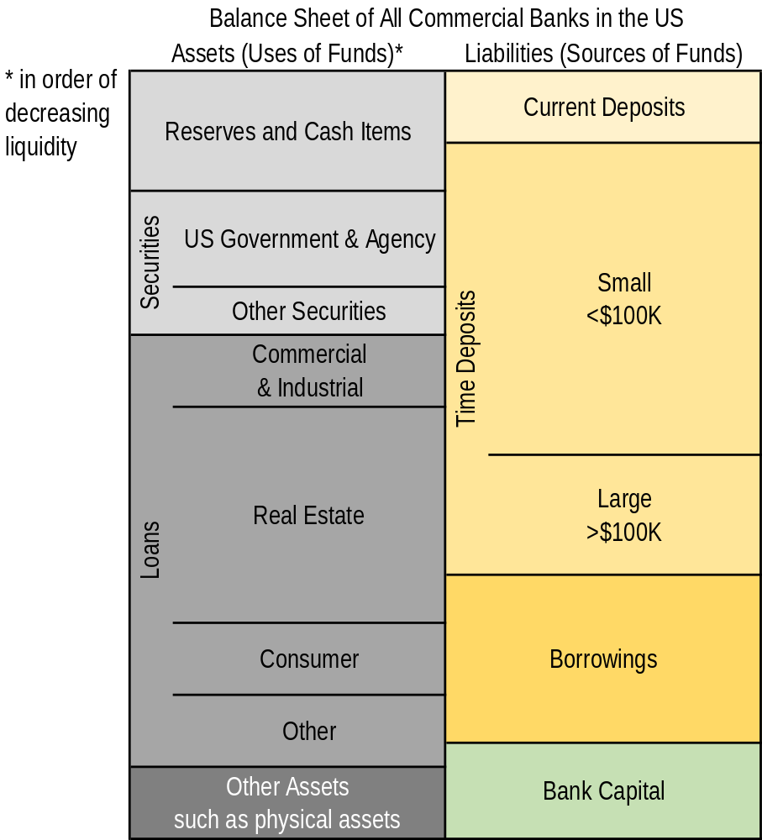
NTE 1010 – Introduction to Finance for Engineers
Banks
Balance Sheet

Slide 4
NTE 1010 – Introduction to Finance for Engineers
Banks
Asset Transformation
Banks make profits through the process of asset transformation:
They borrow short (accept short-term deposits)
and lend long (make long-term loans).
When a bank takes in additional deposits, it gains an equal amount of reserves;
when it pays out deposits, it loses an equal amount of reserves.

Slide 5
NTE 1010 – Introduction to Finance for Engineers
Banks
Bank Management
The bank manager has four primary concerns.
To make sure that the bank has enough ready cash to pay its depositors
when there are deposit outflows
– that is, when deposits are lost because depositors make withdrawels and demand payment.
To keep enough cash on hand, the bank must engage in Liquidity Management,
the acquisition of sufficiently liquid assets to meet the bank’s obligations to depositors.
Pursuing an acceptably low level of risk
by acquiring assets that have a low rate default
and by diversifying asset holdings (Asset Management).
Acquring funds at low cost (Liability Management).
Deciding the amount of capital the bank should maintain
and then acquiring the needed capital (Capital Adequacy Management).

Slide 6
NTE 1010 – Introduction to Finance for Engineers
Banks
Banking Risks
Primary risks in banking are as follows.
Credit Risk
The risk arising because borrowers may default.
Interest-rate Risk
The riskiness of earnings and returns on bank assets
that results from interest-rate changes.

Slide 7
NTE 1010 – Introduction to Finance for Engineers
Banks
Bank Management
Although more-liquid assets tend to earn lower returns, banks still desire to hold them.
Specifically, banks hold excess and secondary reserves
because they provide insurance against the costs of a deposit outflow.
Banks manage their assets to maximize profits
by seeking the highest returns possible on loans and securities
while at the same time trying to lower risk and making adequate provisions for liquidity.
Although liability management was once a staid affair,
large (money center) banks now actively seek out sources of funds
by issuing liabilities such as negotiable CDs
or by actively borrowing from other banks and corporations.
Banks manage the amount of capital they hold
to prevent bank failure
and to meet bank capital requirements set by the regulatory authorities.
However, they do not want to hold too much capital
because by so doing they will lower the returns to equity holders.

Slide 8
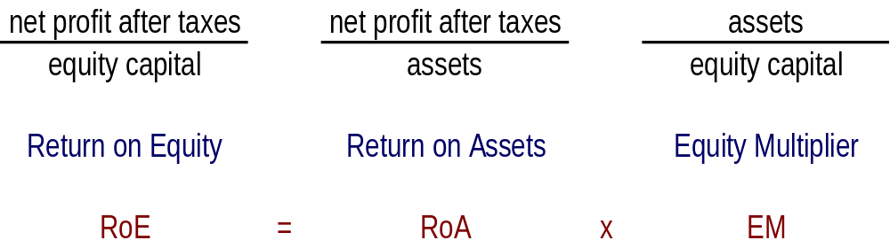
NTE 1010 – Introduction to Finance for Engineers
Banks
Equity Multiplier
Higher bank capital benefits the owners of a bank
in that it makes their investment safer by reducing the likelyhood of bankruptcy.
But bank capital is costly
because the higher it is, the lower will be the return on equity
for a given return on assets.
The bank management needs to aim for an optimal capital level
balancing the avoidance of bankruptcy and the maximization of return on equity.

Slide 9
NTE 1010 – Introduction to Finance for Engineers
Banks
Credit Risk Management
Credit risk management principles
involving loan activities
are the following:
  screening and monitoring
  long-term customer relationships
  loan commitments
  collateral and compensating balances
  credit rationing

Slide 10
NTE 1010 – Introduction to Finance for Engineers
Banks
Credit Risk Management
  Screening and Monitoring:
  Asymmetric information is present in loan markets because lenders have less information
  about the investment opportunities and activities of borrowers than borrowers do.
  This situation leads to two information-producing activities by banks and other financial institutions
  – screening and monitoring.
  For effective screening, lenders must collect reliable information from prospective borrowers.
  Bank collects information about the company’s profits and losses (income) and about its assets and liabilities.
  The lender also has to evaluate the likely future success of the business.
  So, in addition to obtaining information on such items as sales figures,
  a loan officer might ask questions about
  the company’s future plans, the purpose of the loan, and the competition in the industry.
  The officer may even visit the compant to obtain a firsthand look at its operations.
  A lender should write provisions (restrictive covenants) into loan contracts
  that restrict borrowers from engaging in risky activities.
  By monitoring borowers’ activities to see whether they are complying with the restrictive covenants
  and by enforcing covenants if they are not,
  lenders can make sure that borrowers are not taking risks at their expense.

Slide 11
NTE 1010 – Introduction to Finance for Engineers
Banks
Credit Risk Management
  Long-term Customer Relationships:
  Reduce the costs of information collection and make it easier to screen out bad credit risks.
  The costs of monitoring long-term customers are lower.
  Long-term relationships benefit the customer as well as the bank.
  The long-term customer has the incentive to avoid risky activities that would upset the bank,
  even if restrictions on these risky activities are not specified in the loan contract.

Slide 12
NTE 1010 – Introduction to Finance for Engineers
Banks
Credit Risk Management
  Loan Commitments:
  A loan commitment is a bank’s commitment (for a specified future period of time)
  to provide a firm with loans up to a given amount
  at an interest rate that is tied to some market interest rate.
  The advantage for the firm is that it has a source of credit when it needs it.
  The advantage for the bank is that the loan commitment promotes a long-term relationship,
  which in turn facilitates information collection.
  In addition, provisions in the loan commitment agreement require that
  the firm continually supply the bank with information
  about the firm’s income, asset and liability position, business activities, and so on.

Slide 13
NTE 1010 – Introduction to Finance for Engineers
Banks
Credit Risk Management
  Collateral and Compensating Balances:
  Collateral, which is property promised to the lender as compensation if the borrower defaults
  lessens the adverse consequences
  because it reduces the lender’s losses in the case of a loan default.
  One particular form is called Compensating Balances:
  A firm receiving a loan is asked to keep
  a required minimum (on the average) amount of funds in a checking account at the bank.
  The bank can observe the firm’s check payment practices,
  which may yield a great deal of information about the borrower’s financial condition.

Slide 14
NTE 1010 – Introduction to Finance for Engineers
Banks
Credit Risk Management
  Credit Rationing:
  Credit rationing takes two forms.
  A lender refuses to make a loan of any amount to a borrower,
  even if the borrower is willing to pay a higher interest rate.
  Individuals and firms with the riskiest investment projects are exactly those
  that are willing to pay the highest interest rates.
  A lender is willing to make a loan but restricts the size of the loan
  to less than the borrower would like.
  Because more borrowers repay their loans if the loan amounts are small, financial institutions ration credit by providing borrowers with smaller loans than they seek.

Slide 15
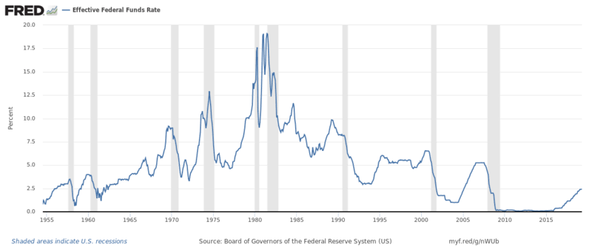
NTE 1010 – Introduction to Finance for Engineers
Banks
Interest-Rate Risk
With the increased volatility of interest rates that occured in the 1980s,
the financial institutions became more concerned about their exposure to interest-rate risk.
US Interest Rates

Slide 16
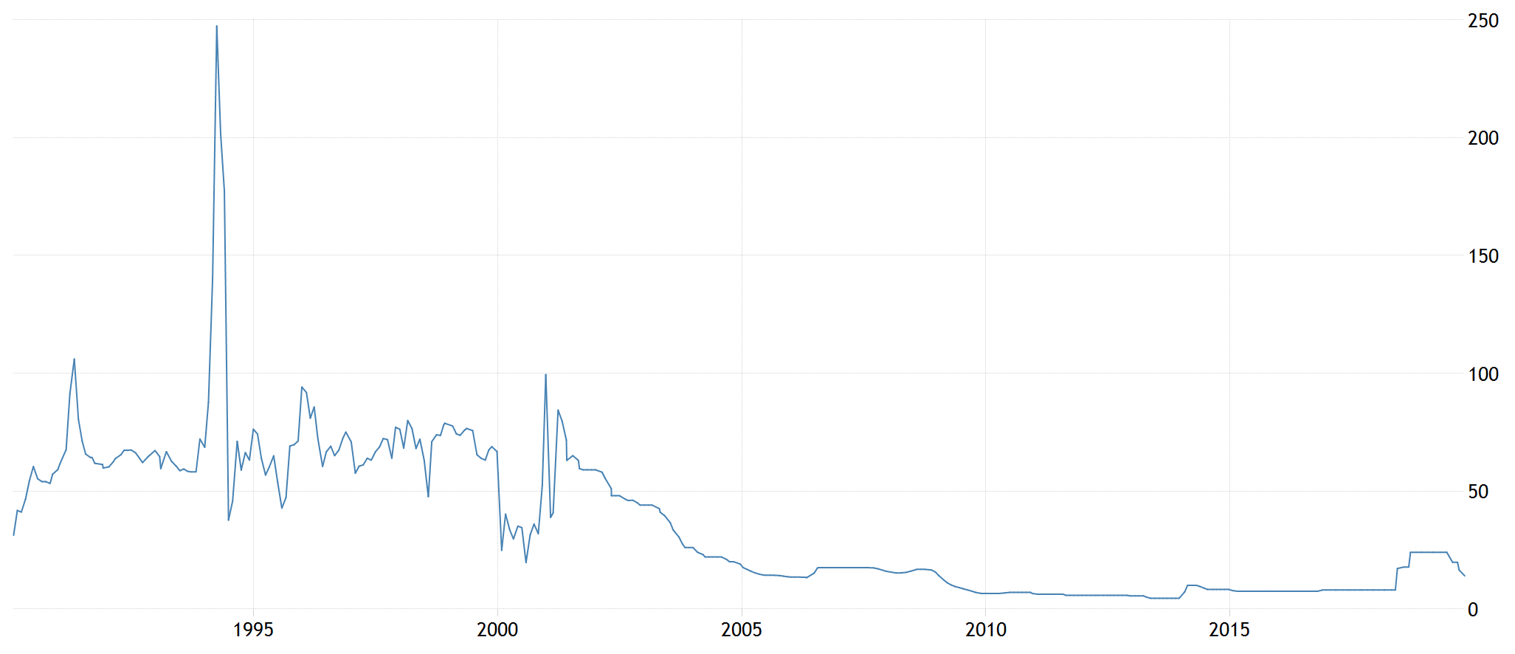
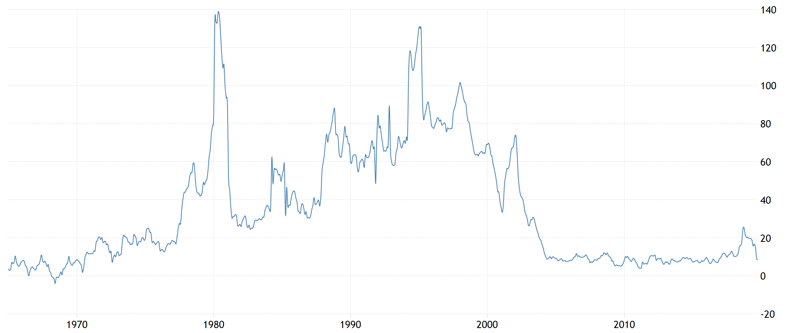
NTE 1010
Introduction to
Finance
for Engineers
Banks
Interest-Rate Risk
Interest Rates in Turkey
Inflation Turkey

Slide 17
NTE 1010 – Introduction to Finance for Engineers
Banks
Estimating the Size of the Interest-Rate Risk
Gap and duration analyses tell a financial institution
if it has more rate-sensitive liabilities than assets
[″rate-sensitive″ = with interest rates that change frequently (at least once a year)
″fixed-rate″ = with interest rates that remain unchanged for a long period (over a year)]
in which case a rise in interest rates will reduce profits
and a fall in interest rates will raise profits.
Gap = rate-sensitive Liabilities – rate-sensitive Assets
By multiplying the Gap times change in interest rate,
we can immediately obtain the effect on bank profits.
Duration = the average lifetime of a security’s stream of payments
By multiplying the weighted average duration of a bank’s assets and of its liabilities
times the amount of assets and of liabilities
times change in interest rate,
we can immediately obtain the approximate effect on bank’s total asset value.
Financial institutions manage their interest-rate risk by modifying their balance sheets
but can also use strategies involving financial derivatives.

Slide 18
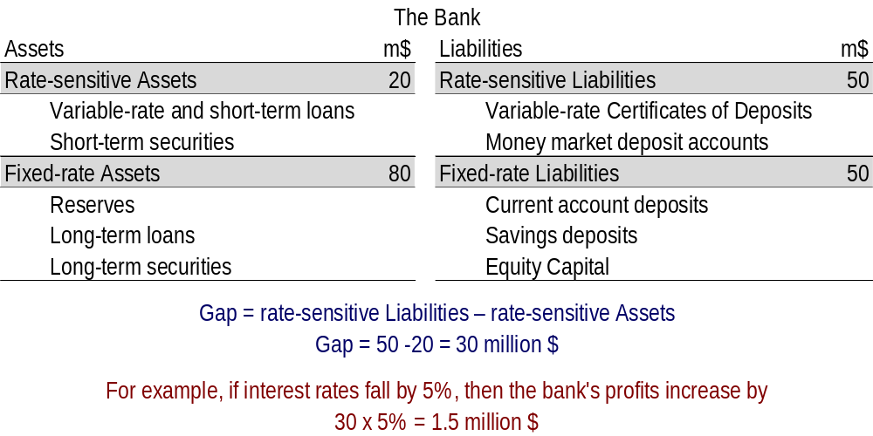
NTE 1010 – Introduction to Finance for Engineers
Banks
Estimating the Size of the Interest-Rate Risk
Gap Analysis

Slide 19
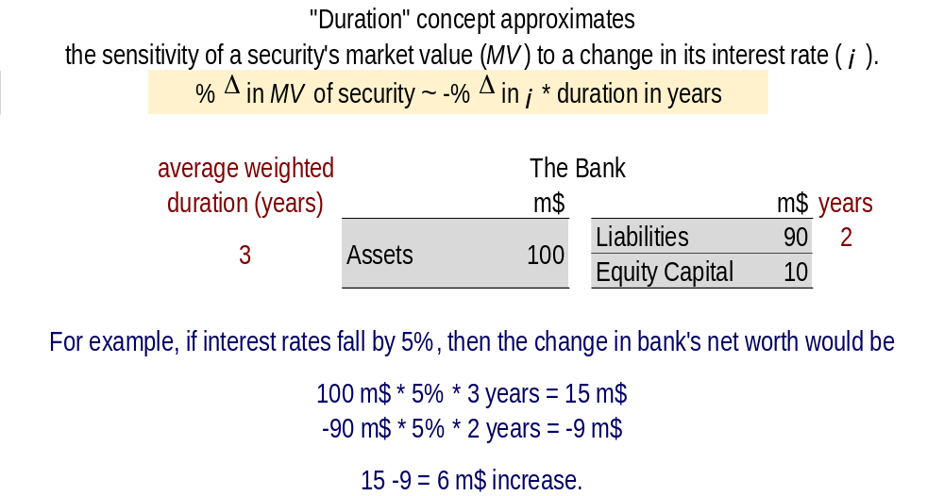
NTE 1010 – Introduction to Finance for Engineers
Banks
Estimating the Size of the Interest-Rate Risk
Duration Analysis
Duration = the average lifetime of a security’s stream of payments

Slide 20
NTE 1010 – Introduction to Finance for Engineers
Banks
Off-Balance-Sheet Activities
Off-balance-sheet activities consist of trading financial instruments
and generating income from fees and loan sales,
all of which affect bank profits but are not visible on bank balance sheets.
Because these off-balance-sheet activities expose banks to increased risk,
bank management must pay particular attention to
risk assessment procedures and internal controls
to restrict employees from taking on too much risk.

